Slide 1
Fiddler

Slide 2
What is Fiddler?
Web Debugging Proxy which logs all HTTP(S) traffic between your computer
and the Internet.
Runs as a local proxy; registers as system proxy while capturing.
View, analyze and modify web traffic from any application that supports a proxy;
including most devices.
Includes a powerful event-based scripting subsystem, and can be extended
using any .NET language.
Freeware and can debug traffic from virtually any application that supports a proxy.

Slide 3
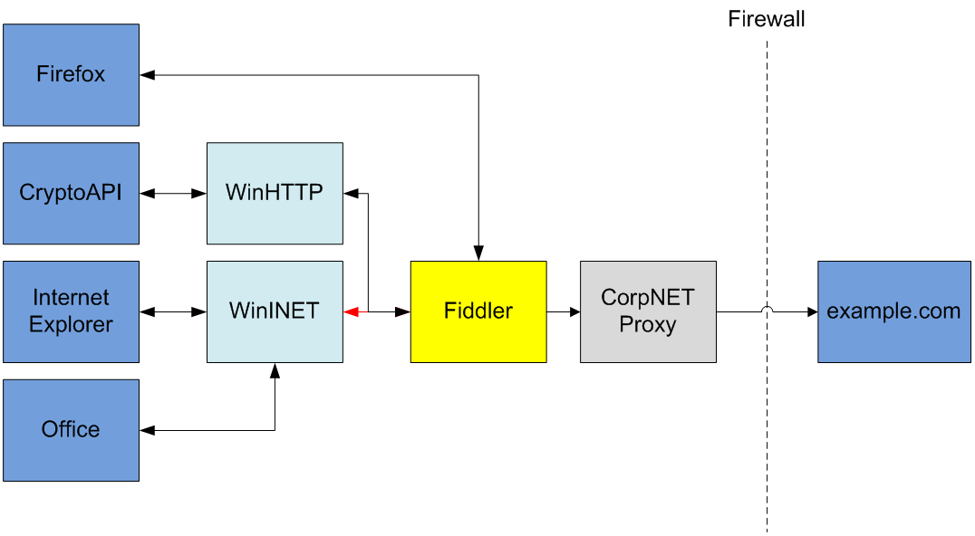
Fiddler Architecture

Slide 4
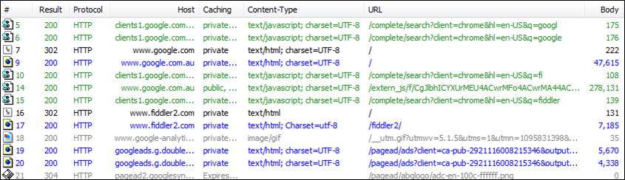
Web Sessions
Web Sessions pane is where the traffic is displayed as it is captured:

Slide 5
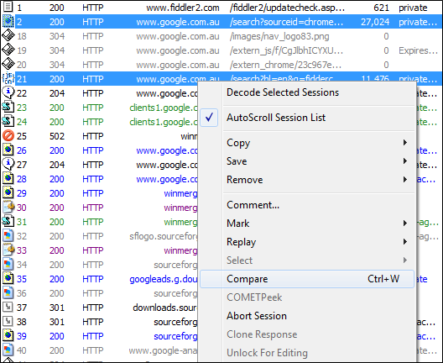
Traffic Comparison
One little known awesome feature of Web Sessions is the ability to compare two sessions. To compare
two sessions select them in the Web Sessions pane, right click and choose ‘Compare’ item from the menu.

Slide 6
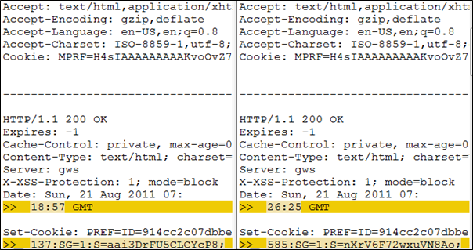
Traffic Comparison
Compare sessions example

Slide 7
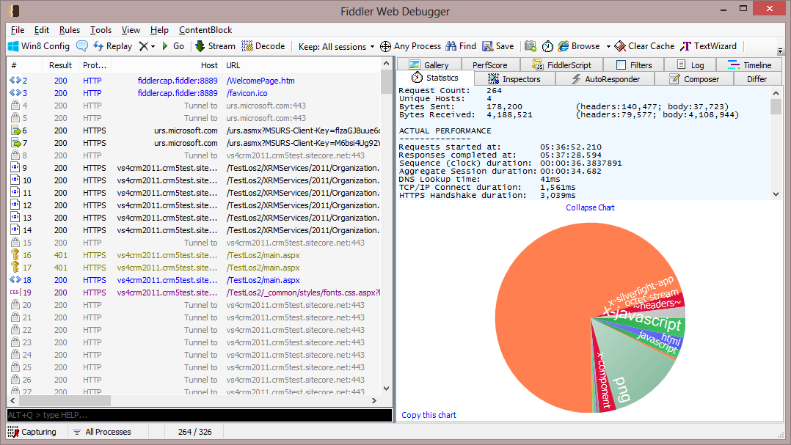
Statistics
The first tab on the right pane is Statistics which shows you some info about the selected session.
It is most useful when used on several sessions:

Slide 8
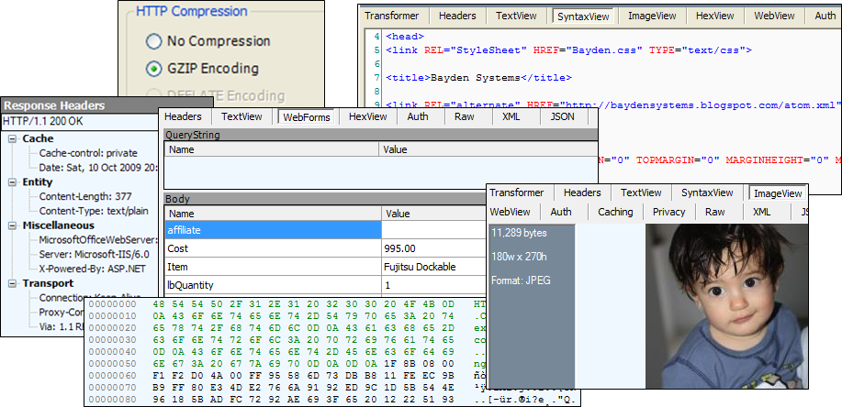
Inspectors
Inspectors allow you to visualize requests and responses in meaningful ways.
When you double click on a session fiddler takes you to the Inspectors tab for that session. It also
detects what the most relevant request and response inspectors are and chooses that for you. For
example if you double click on a JSON session, Fiddler takes you to the JSON tab.

Slide 9
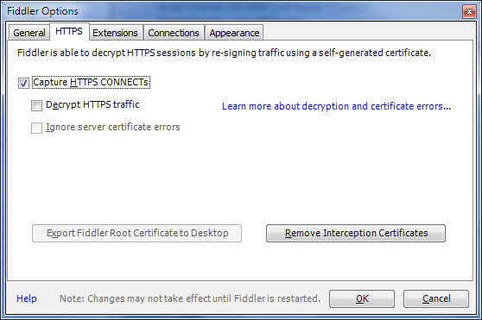
HTTPS Traffic Decryption
Fiddler can decipher HTTPS traffic. It can only do so for the traffic going through it and by your
permission. By default Fiddler does not decipher HTTPS traffic and you should explicitly ask it to do
so. In order to activate HTTPS traffic decryption:
- Go to Tools -> Fiddler Options -> HTTPS tab
- Tick Capture HTTPS CONNECTS and Decrypt HTTPS traffic checkboxes.

Slide 10
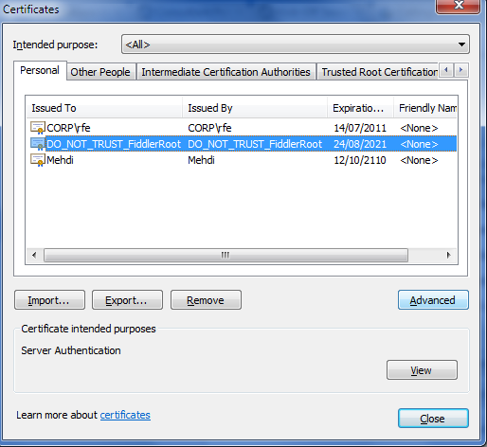
HTTPS Traffic Decryption
Clicking yes on this box installs Fiddler’s certificate in your Personal store:

Slide 11
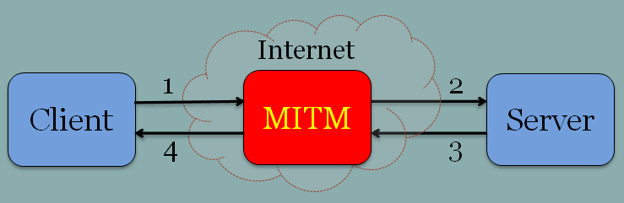
HTTPS Traffic Decryption
Fiddler uses a hacking technique called Man-In-The-Middle Attack to decrypt HTTPS traffic:
So while the client and server are unaware of MITM, the whole traffic has been monitored and perhaps modified. Fiddler does pretty much the same thing except that you know it is sitting in the middle.

Slide 12
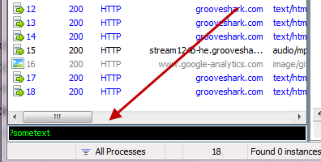
QuickExec
Fiddler's QuickExec box allows you to launch script-commands quickly.

Slide 13
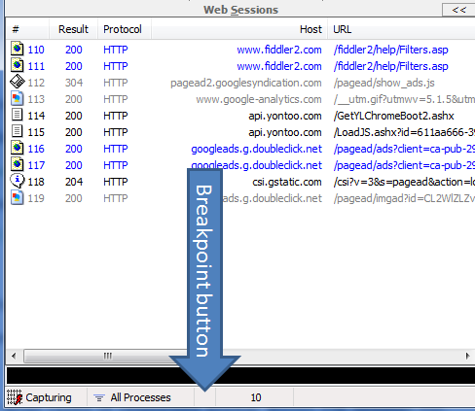
Set breakpoints
Fiddler provides us with a few ways to set breakpoints.
1. Use the small button on the status bar to set breakpoints.

Slide 14
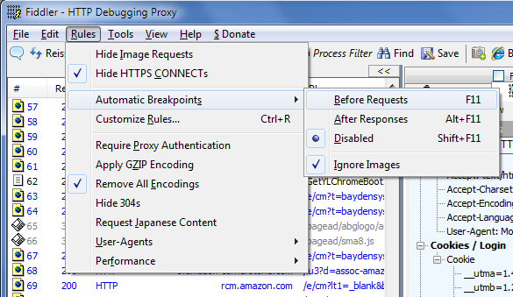
Set breakpoints
2. Automatic Breakpoints menu You can achieve the same result using menus.

Slide 15
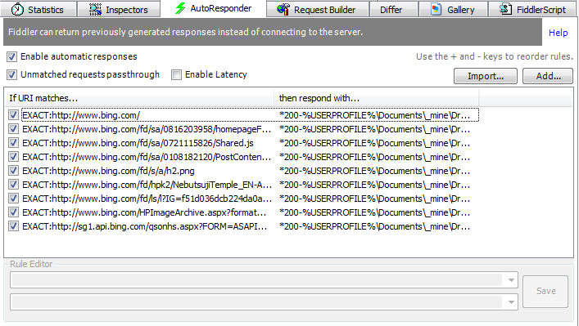
AutoResponder
Replay previously-captured or generated traffic.

Slide 16
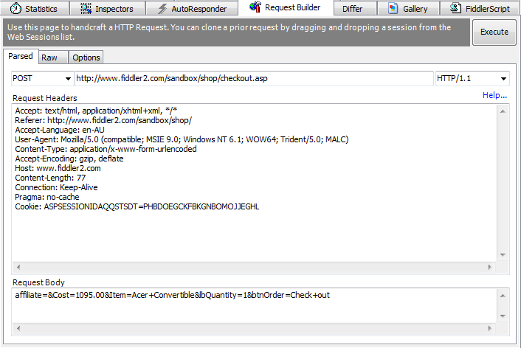
RequestBuilder
The Request Builder allows you to craft custom requests to send to a server.

Slide 17
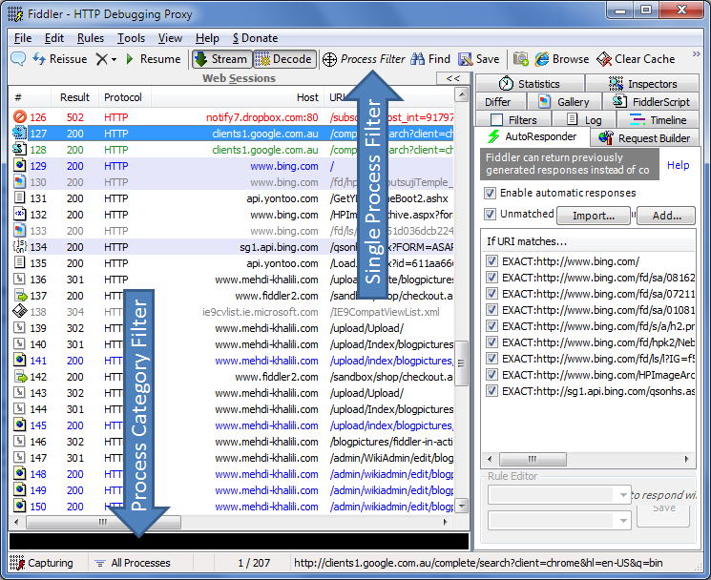
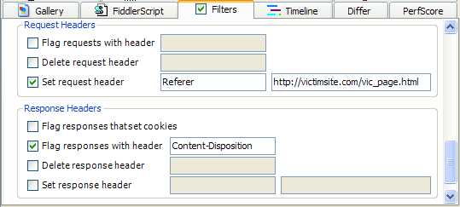
Filters
Flag, modify or remove headers from all requests and responses.

Slide 18
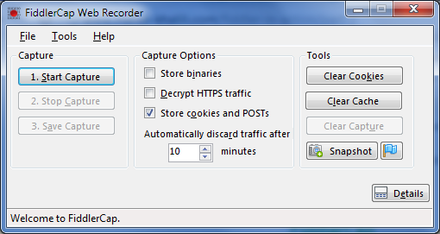
FiddlerCap
To capture your Web Traffic, and send that capture to a debugging buddy who can troubleshoot the bug.

Slide 19
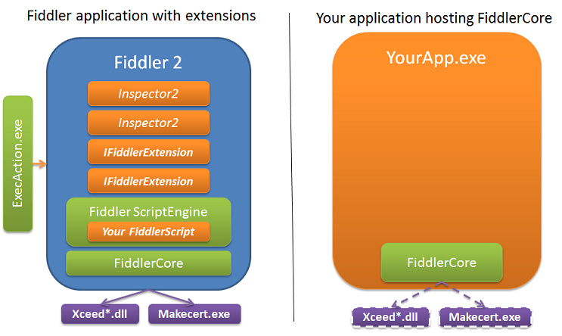
FiddlerCore
FiddlerCap uses FiddlerCore which is a .Net library in the heart of Fiddler:

Slide 20
Thank you!

